Slide 1
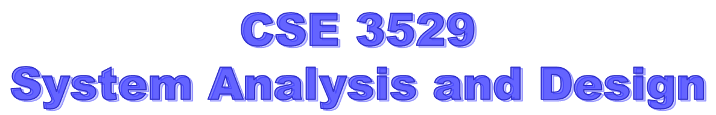
International Islamic University Chittagong

Slide 2
System/Software maintenance
Software maintenance is defined by the IEEE as:
“Modification of a software product after delivery to correct faults, to improve performance or other attributes, or to adapt the product to a modified environment.”
So any work done to change the software after it is in operation is considered to be maintenance work. The purpose is to preserve the value of software over the time. The value can be enhanced by expanding the customer base, meeting additional requirements, becoming easier to use, more efficient and employing newer technology.
Maintenance may span for 20 years, whereas development may be 1-2 years.

Slide 3
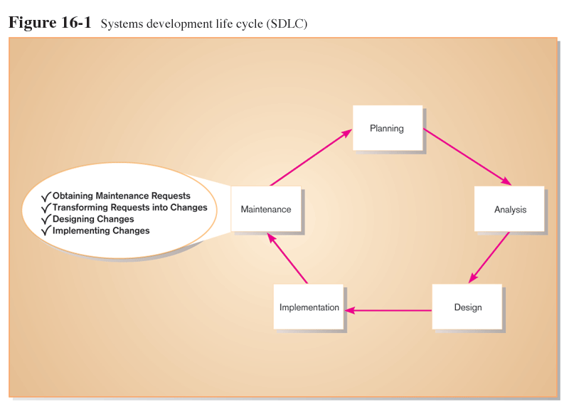

Slide 4
The Process of Maintaining Information Systems
Process of returning to the beginning of the SDLC and repeating development steps focusing on system change until the change is implemented
Maintenance is the longest phase in the SDLC
Four major activities:
  Obtaining maintenance requests
  Transforming requests into changes
  Designing changes
  Implementing changes

Slide 5
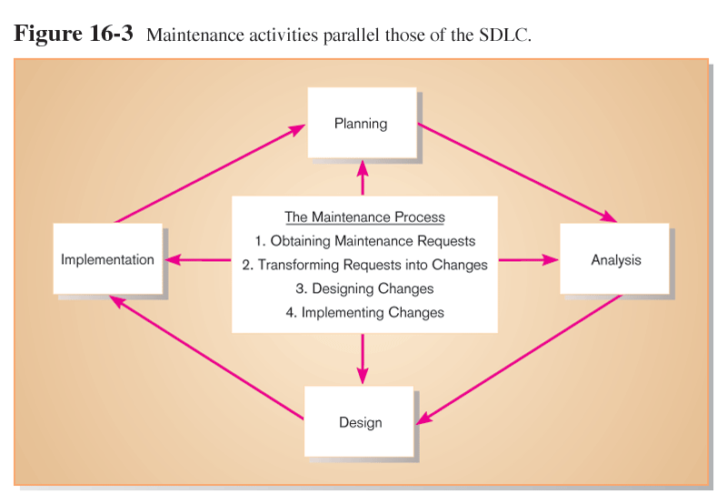
Maintenance is like a mini-SDLC

Slide 6
Types of System Maintenance
Adaptive – modifying the system to cope with changes in the software environment (DBMS, OS).
Perfective – implementing new or changed user requirements which concern functional enhancements to the software.
Corrective – diagnosing and fixing errors, possibly ones found by users.
Preventive – increasing software maintainability* or reliability to prevent problems in the future
* maintainability measures the ease and speed with which a system can be restored to operational status after a failure occurs.

Slide 7
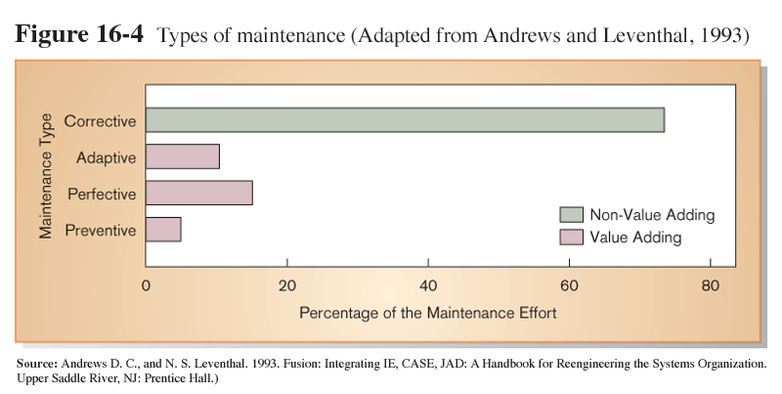
By far, most maintenance is corrective, and therefore urgent and non-value adding.

Slide 8
Corrective maintenance vs adaptive maintenance
In computer science, corrective maintenance is accomplished by removing bugs from software, hardware and the network, while adaptive maintenance describes the adaptive modification of existing code/system to new platform/Environment.
Corrective maintenance is generally categorized into emergency situations - such as a network outage or virus attack - and preventive ones - such as repairs and maintenance to prevent the repetition of these events. Adaptive maintenance is used as a proactive and reactive response to changing business trends and needs.
In short, corrective maintenance is a fixing what's wrong, while adaptive maintenance is used to upgrade the system to better confront the challenges that lie ahead.

Slide 9
The Cost of Maintenance
Software maintenance cost is derived from the changes made to software after it has been delivered to the end user.
Software maintenance costs include:
Corrective maintenance – generally 20% of software maintenance costs
Adaptive maintenance – 25% of software maintenance costs
Preventive maintenance – generally 5% of software maintenance costs
Perfective maintenance – generally 50% or more of software maintenance costs

Slide 10
Factors that influence system maintainability
Software maintainability is defined as the degree to which an application is understood, repaired, or enhanced. Factors that influence system maintainability are:
1. Latent defects -- The number of unknown errors existing in the system after installation.
2. Number of customers for a given system - Higher cost for higher number of customers/users.
3. Quality of system documentation - quality of technical system documentation including test cases.
4. Maintenance personnel - Number and quality of personnel dedicated to the support and maintenance of the system

Slide 11
Factors that influence system maintainability (Contd)
5.Tools - Software development tools, debuggers, hardware and other resources. Tools such as those that can automatically produce system documentation where none exists can also lower maintenance costs.
6.Sotware structure - Well-structured programs make it much easier to understand and fix programs.

Slide 12
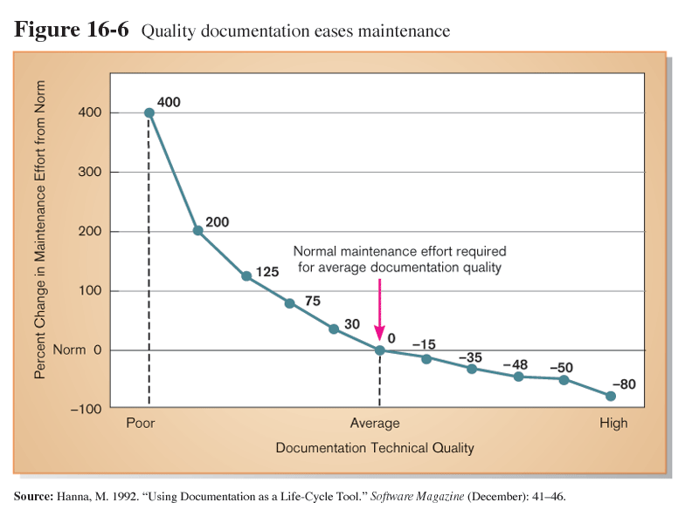
A well-documented system is easier to understand, and therefore easier to maintain.

Slide 13
Conducting System Maintenance
Number of people working in maintenance has surpassed number working in development.
Three possible organizational structures:
  Separate
    Maintenance group consists of different personnel than development group.
  Combined
    Developers also maintain systems.
  Functional
    Maintenance personnel work within the functional business unit.

Slide 14
Advantages and Disadvantages
Maintenance Organization Type | Advantages | Disadvantages
Separate | Improved system and documentation quality | Ignorance of critical undocumented information
Combined | Maintenance group knows all about system | Less emphasis on good documentation
Functional | Personnel have vested interest | Limited job mobility and human or technical resources

Slide 15
Conducting System Maintenance
Measures of Effectiveness
Important factors to consider
  Number of failures
  Time between each failure
  Type of failure
Mean time between failures (MTBF)
  Mean time between failures (MTBF) is the predicted elapsed time between inherent failures of a mechanical system, during normal system operation.
  MTBF can be calculated as the arithmetic mean (average) time between failures of a system.
  A measurement of error occurrences that can be tracked over time to indicate the quality of a system

Slide 16
Controlling Maintenance Requests
Based on the type of request, some method of prioritizing requests must be determined.
Possible types of request:
Error ( i.e a corrective maintenance request)
Adaptation ( i.e request is to adapt the system to technology or business change)
Enhancement (i.e request is to enhance the system so that it will provide new business functionality) Prioritizing scheme:
The below figure shows a flowchart for controlling maintenance requests

Slide 17
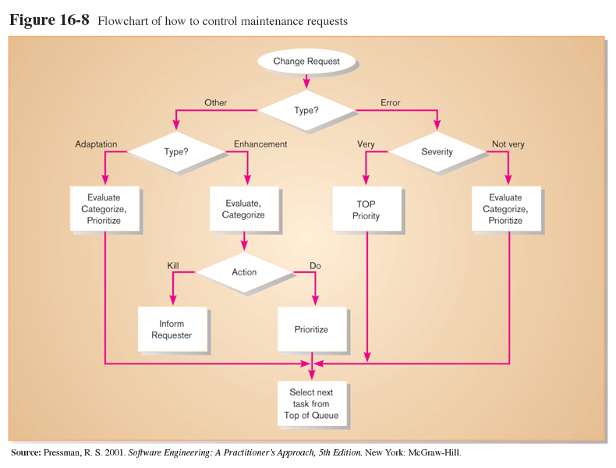
Controlling Maintenance Requests
Maintenance requests can be frequent
Prioritize based on type and urgency of request

Slide 18
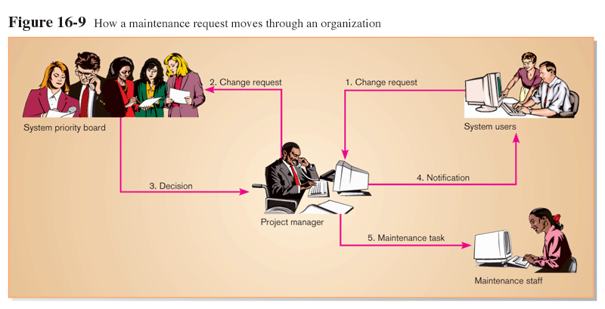
The Flow of a Maintenance Request
Evaluations are based on feasibility analysis

Slide 19
Configuration Management
In software engineering, software configuration management (SCM or S/W CM) is the task of tracking and controlling changes in the software, part of the larger cross-disciplinary field of configuration management.
SCM practices include revision control and the establishment of baselines. If something goes wrong, SCM can determine what was changed and who changed it. If a configuration is working well, SCM can determine how to replicate it across many hosts.
The process of assuring that only authorized changes are made to the system.

Slide 20
Configuration Management
Baseline modules
  Software modules that have been tested, documented, and approved to be included in the most recently created version of a system. A system librarian controls the baseline source code modules.
System librarian
  A person responsible for controlling the checking out and checking in of baseline modules when a system is being developed or maintained.

Slide 21
Configuration Management (Contd)
It is the responsibility of the system librarian to keep copies of all prior versions of all system modules including the build routines needed to construct any version of the system that ever existed. It may be important to build old versions of the system if new ones fail, or to support users that cannot run newer versions on their computer system.
Build routines
  Guidelines that list the instructions to construct an executable system from the baseline source code.

Slide 22
Configuration Management Tools
Special software systems for managing system configuration
Controls access to modules in the system library
Two types
  Revision control: modules labeled as frozen (unchangeable) or floating (checked out by programmer for modification)
  Source code control: extend revision control to all interrelated modules
Historical changes can be traced and previous versions can be reconstructed

Slide 23
Role of CASE and Automated Development Tools in Maintenance
Traditional systems development
  Emphasis on coding and testing.
  Changes are implemented by coding and testing first.
  Documentation is done after maintenance is performed.
  Keeping documentation current is often neglected due to time-consuming nature of task.
Development with CASE
  Emphasis is on design documents.
  Changes are implemented in design documents.
  Code is regenerated using code generators.
  Documentation is updated during maintenance.

Slide 24
Website Maintenance
Special considerations
  24 X 7 X 365 (?)
    Nature of continuous availability makes maintenance challenging
    Pages under maintenance can be locked
    Date and time stamps may be included to indicate the most recent changes.
  Check for broken links
  HTML Validation
    New Pages should be processed by a code validation routine before publication.

Slide 25
Website Maintenance
Special considerations (continued)
  Re-registration
    When content significantly changes, site may need to be re-registered with search engines
  Future Editions
    Consistency is important to users
    Post indications of future changes to the site
    Batch changes to reduce the frequency of site changes.

